Slide 1
Lecture no. 4

Slide 2
Levels of Planning

Slide 3
Levels of Planning
There are five levels of planning
Local level planning
Country level planning
Regional planning
National Planning
International Planning

Slide 4
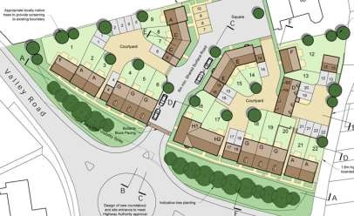
1. Local Level Planning
The development plan of a city or a town is prepared by keeping in view the local conditions. It aims at proper distribution of population density, regulation of traffic, location of shopping and recreation center etc. It is quite evident that local planning will be greatly influenced by economic conditions and finances available for the development of the town.

Slide 5
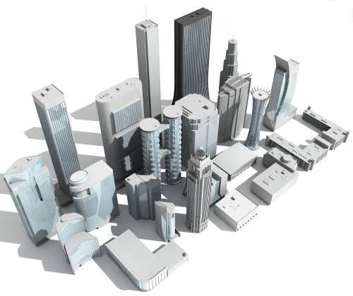
2. Country Level Planning
The area surrounding a town cannot be allowed to develop in a haphazard way. Generally a town is surrounded by villages and rural planning becomes necessary for the proper functioning of the town. For this purpose, the surrounding villages should be linked up with suitable transport facilities . It should be remembered that country planning and Urban planning are complementary to each other they cannot be treated as two independent separate entities.

Slide 6
3. Regional Planning
The term regional planning is used to include proposals in a region for the distribution of population and industry , transport facilities, rural services , village industries, etc.
A Town or a city cannot be isolated from its surrounding region. Hence , regional planning helps in controlling and reshaping the growth of major town in the region.

Slide 7
4. National Planning
National level is the level set by higher authorities of planning and development in order to provide better facilities and infrastructure at national level. Planner is not only concerned with regional (urban or rural level) but with national level as well. It is implemented by obeying various polices and guidelines in order to provide facilities and better living on a country level to enhance the beautification and living environment of the country.
National Level is to provide proper housing facilities along with the basic infrastructure as the proper accessibility to the amenities like parks, hospitals, education and offices, recreational and commercial zones and industrial zones along with proper roads and drainage and sewerage system as to give a livable environment to the citizens of a country. So as they should not suffer for the availability or the accessibility of any of the above-mentioned aspects.

Slide 8
5. International Planning
With the establishment of United Nations Organization (UNO), international planning come into existence and efforts are made at international level to promote good will and co-operation between different countries of the world. Various agencies appointed by UNO conduct surveys in various fields of human life such as health, education, food etc. The study of such surveys helps in finding out remedies of complicated problems at international level.

